Slide 1


Chapter 4
Networking and the Internet
© 2007 Pearson Addison-Wesley.
All rights reserved

Slide 2
Chapter 4: Networking and the Internet
4.1 Network Fundamentals
4.2 The Internet
4.3 The World Wide Web
4.4 Internet Protocols
4.5 Security
© 2007 Pearson Addison-Wesley. All rights reserved
0-<number>

Slide 3
Network Classifications
Scope
  Local area network (LAN)
  Metropolitan area (MAN)
  Wide area network (WAN)
Ownership
  Closed versus open
Topology (configuration)
  Ring
  Bus
  Star
© 2007 Pearson Addison-Wesley. All rights reserved
0-<number>

Slide 4
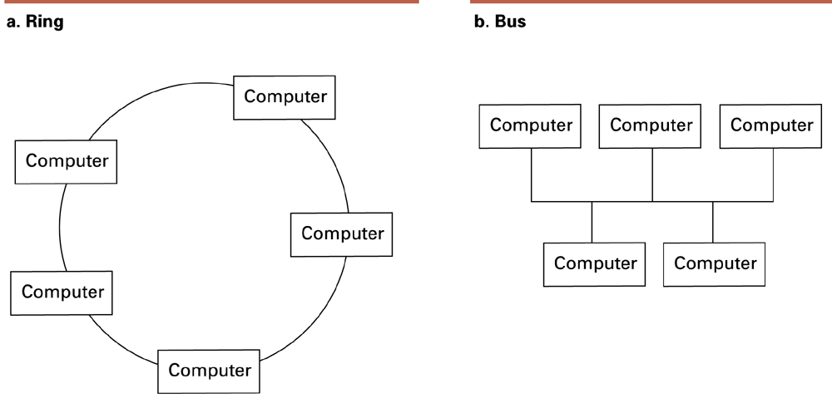
Figure 4.1 Network topologies
© 2007 Pearson Addison-Wesley. All rights reserved
0-<number>

Slide 5
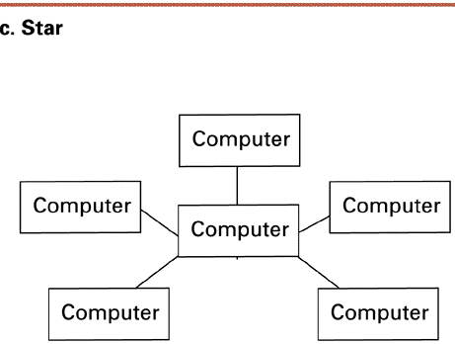
Figure 4.1 Network topologies (continued)
© 2007 Pearson Addison-Wesley. All rights reserved
0-<number>

Slide 6

List of Problems (so far)
Topologies
Framing
Error control
Flow control
Multiple access
  How to share a wire
© 2007 Pearson Addison-Wesley. All rights reserved
0-<number>

Slide 7
Protocols
Token ring
  Popular in ring networks
  Possession of token provides right to introduce new message
CSMA/CD
  Used in Ethernet
  Silent bus provides right to introduce new message
© 2007 Pearson Addison-Wesley. All rights reserved
0-<number>

Slide 8
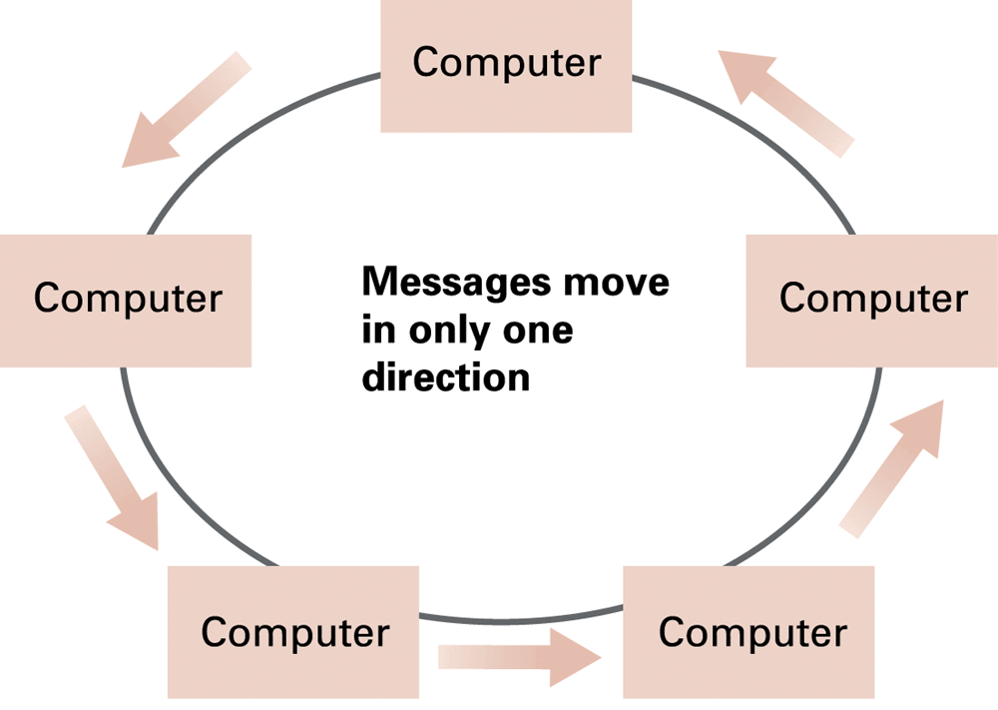
Figure 4.2 Communication over a ring network
© 2007 Pearson Addison-Wesley. All rights reserved
0-<number>

Slide 9
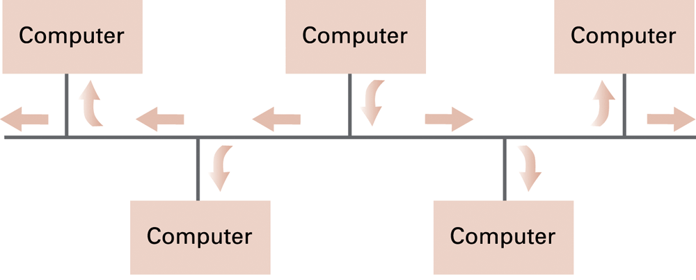
Figure 4.3 Communication over a bus network
© 2007 Pearson Addison-Wesley. All rights reserved
0-<number>

Slide 10
Connecting Networks
Repeater: Extends a network
Bridge: Connects two compatible networks
Switch: Connect several compatible networks
Router: Connects two incompatible networks resulting in a network of networks called an internet
© 2007 Pearson Addison-Wesley. All rights reserved
0-<number>

Slide 11
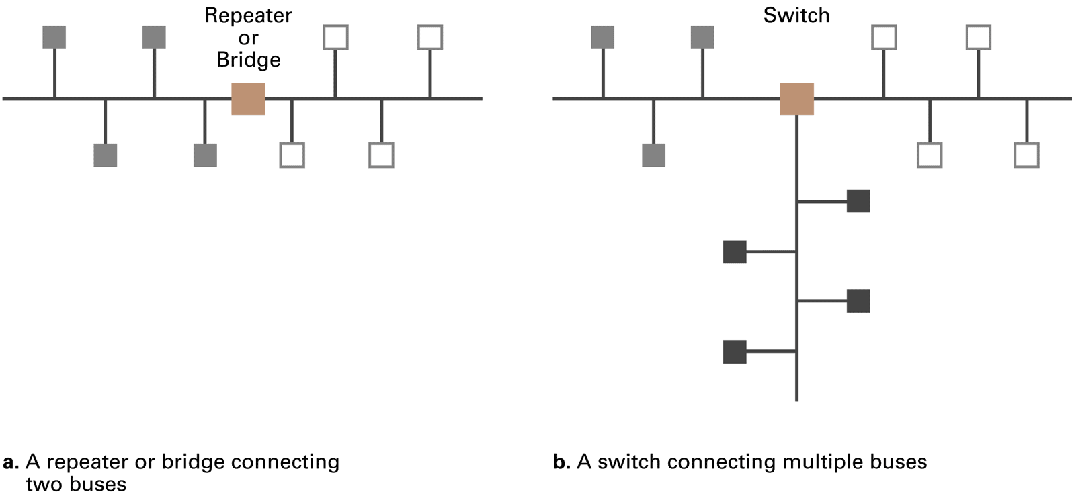
Figure 4.4 Building a large bus network from smaller ones
© 2007 Pearson Addison-Wesley. All rights reserved
0-<number>

Slide 12
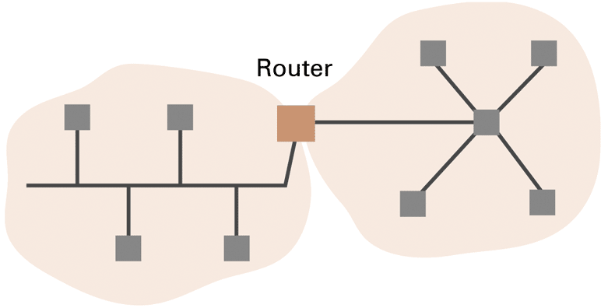
Figure 4.5 A router connecting a bus network to a star network
© 2007 Pearson Addison-Wesley. All rights reserved
0-<number>

Slide 13
Inter-process Communication
Client-server
  One server, many clients
  Server must execute continuously
  Client initiates communication
Peer-to-peer (P2P)
  Two processes communicating as equals
  Peer processes can be short-lived
© 2007 Pearson Addison-Wesley. All rights reserved
0-<number>

Slide 14
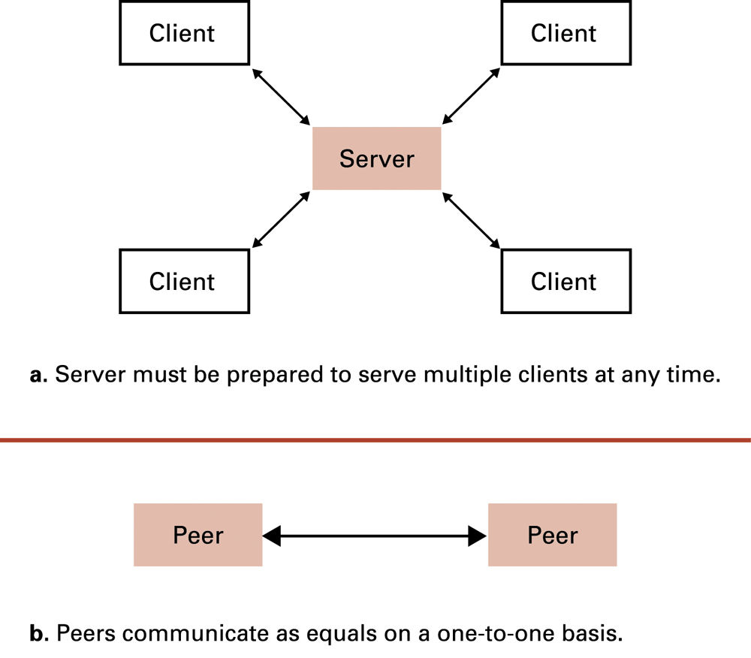
Figure 4.6 The client/server model compared to the peer-to-peer model
© 2007 Pearson Addison-Wesley. All rights reserved
0-<number>

Slide 15
Distributed Systems
Systems with parts that run on different computers
  Infrastructure can be provided by standardized toolkits
    Example: Enterprise Java Beans from Sun Microsystems
    Example: .NET framework from Microsoft
© 2007 Pearson Addison-Wesley. All rights reserved
0-<number>

Slide 16
The Internet
The Internet: An internet that spans the world
  Original goal was to develop a means of connecting networks that would not be disrupted by local disasters.
  Today it has shifted from an academic research project to a commercial undertaking.
© 2007 Pearson Addison-Wesley. All rights reserved
0-<number>

Slide 17
Internet Architecture
Domain: A portion of the Internet that network or internet controlled by a single authority
  Connected to the rest of the Internet (the cloud) by a router called a gateway
Internet Corporation for Assigned Names & Numbers (ICANN): Oversees the registration of domains
Domain Name (www.cs.gsu.edu)
© 2007 Pearson Addison-Wesley. All rights reserved
0-<number>

Slide 18
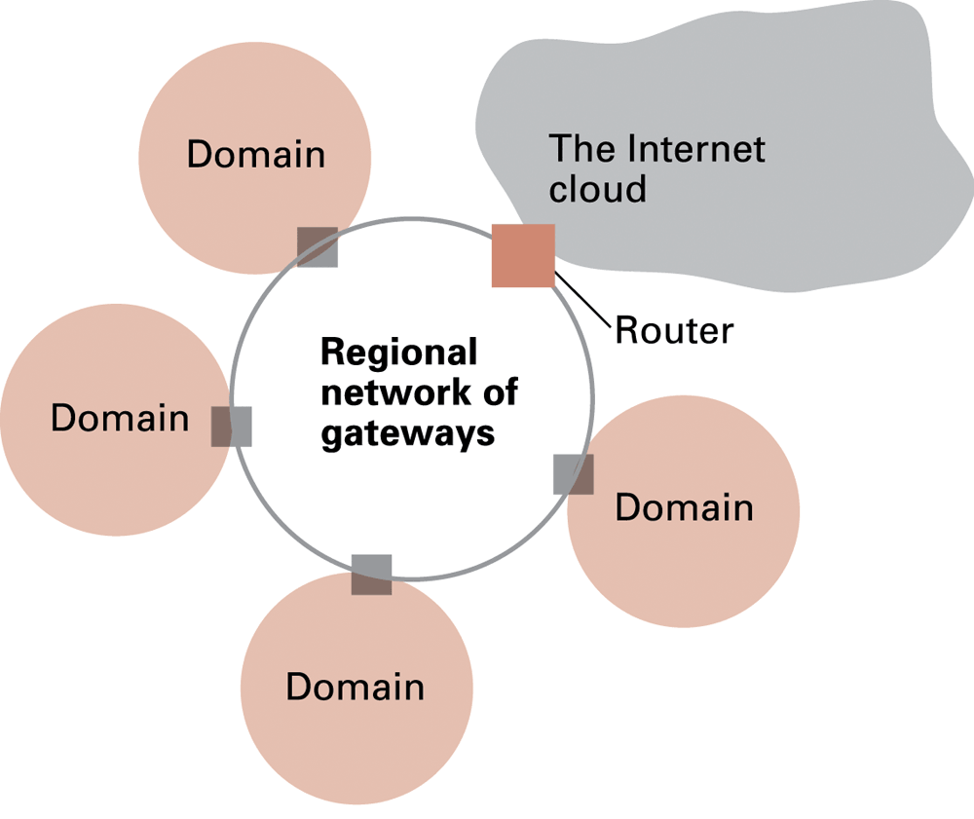
Figure 4.7 A typical approach to connecting to the Internet
© 2007 Pearson Addison-Wesley. All rights reserved
0-<number>

Slide 19
Strategies for connecting to the Internet
Internet Service Provider (ISP): Provides connectivity to the Internet
Popular means of connecting:
  Traditional telephone (dial up connection)
  Cable connections
  DSL (Digital Subscriber Line )
  Wireless
© 2007 Pearson Addison-Wesley. All rights reserved
0-<number>
Notes:
ISP construct and maintain the Internet infrastructure ; provide a significant portion of the computing resources such as data storage and data processing services

Slide 20
Internet Addressing: IP Addresses
IP address: 32 bit identifier for a machine (currently being expanded to a 128 bit system)
  Network identifier: Assigned by ICANN
  Host address: Assigned by domain administrator
Dotted decimal notation: Common notation for displaying IP addresses
  Example: 192.207.177.133
© 2007 Pearson Addison-Wesley. All rights reserved
0-<number>

Slide 21
Internet Addressing: Host Names
Mnemonic address made up of two parts:
  Domain name
    Assigned by a registrar
    Example: gsu.edu
    Top level domain: Classification of domain owner
      By usage – Example: .com = commercial
      By country – Example: .au = Australia
  Subdomains and individual host names
    Assigned by domain owner
    Example: r2d2.compsci.nowhereu.edu
Translation between mnemonic addresses and IP addresses handled by name servers
      .
© 2007 Pearson Addison-Wesley. All rights reserved
0-<number>
Notes:
Network identifier
Host address

Slide 22
Traditional Internet Applications
Electronic Mail (email)
  Domain mail server collects incoming mail and transmits outing mail
  Mail server delivers collected incoming mail to clients via POP3 or IMAP
File Transfer Protocol (FTP)
Telnet and SSH
© 2007 Pearson Addison-Wesley. All rights reserved
0-<number>

Slide 23
Internet Software Layers
Application: Constructs message with address
Transport: Chops message into packets
Network: Handles routing through the Internet
Link: Handles actual transmission of packets
© 2007 Pearson Addison-Wesley. All rights reserved
0-<number>

Slide 24
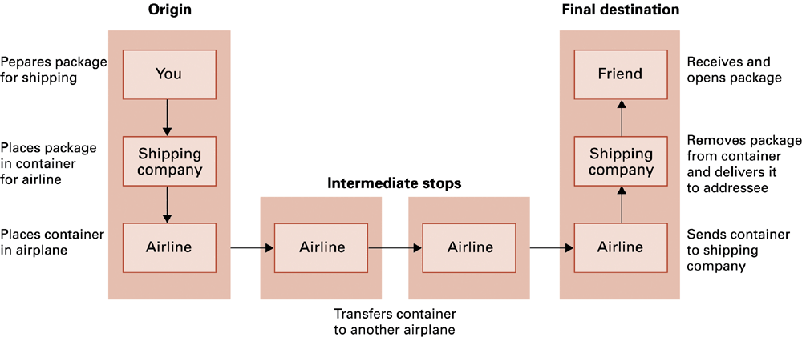
Figure 4.12 Package-shipping example
© 2007 Pearson Addison-Wesley. All rights reserved
0-<number>

Slide 25
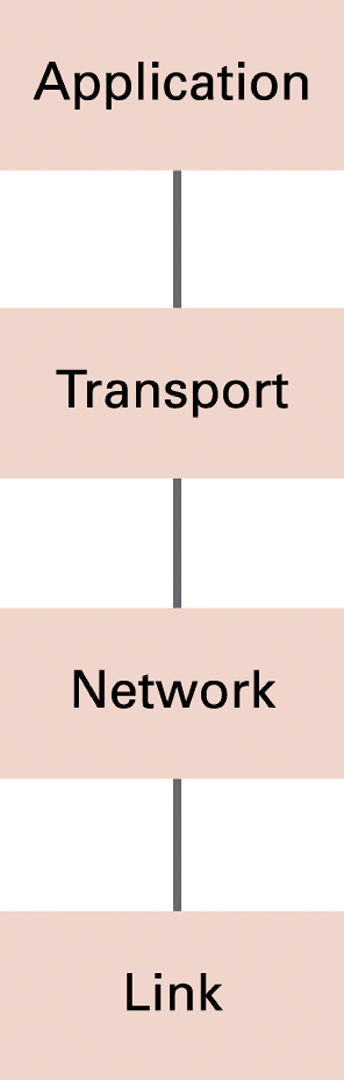
Figure 4.13 The Internet software layers
© 2007 Pearson Addison-Wesley. All rights reserved
0-<number>

Slide 26
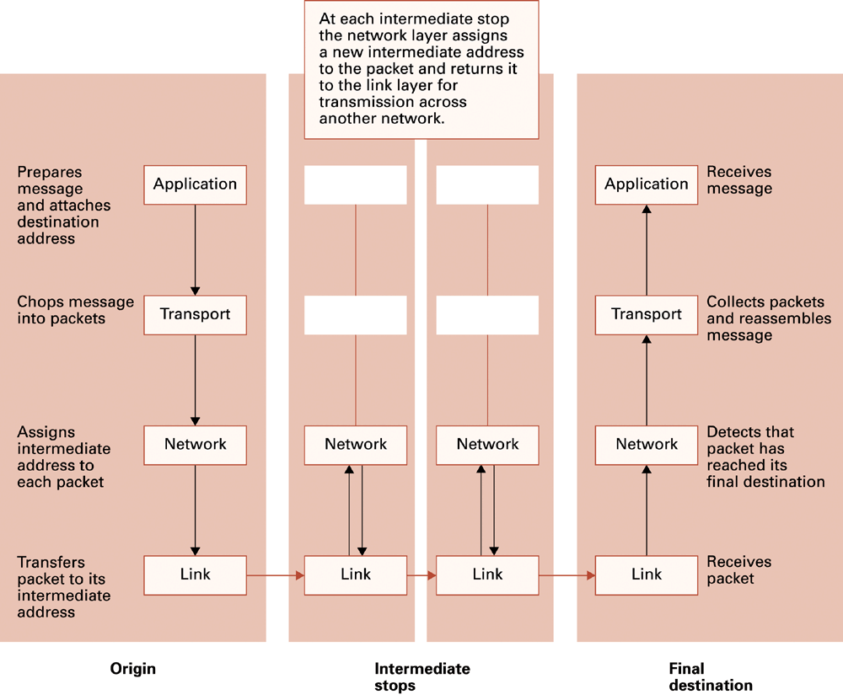
Figure 4.14 Following a message through the Internet
© 2007 Pearson Addison-Wesley. All rights reserved
0-<number>

Slide 27

Layering: logical communication
data
application
transport
network
link
E.g.: transport
take data from app
add addressing, reliability check info to form “datagram”
send datagram to peer
wait for peer to ack receipt
analogy: post office
transport
ack
network
link
physical
application
transport
network
link
data
data
application
transport
network
link
application
transport
network
link
transport
© 2007 Pearson Addison-Wesley. All rights reserved
0-<number>

Slide 28

Layering: physical communication
data
application
transport
network
link
network
link
application
transport
network
link
data
application
transport
network
link
application
transport
network
link
© 2007 Pearson Addison-Wesley. All rights reserved
0-<number>

Slide 29
Protocol layering and data
Each layer takes data from above
adds header information to create new data unit (“encapsulation”)
passes new data unit to layer below
source
destination
M
application
transport
network
link
application
transport
network
link
M
message
H
M
H
t
M
segment
t
H
H
H
H
M
datagram
n
t
M
n
t
H
H
H
H
H
H
M
frame
l
n
t
M
l
n
t
© 2007 Pearson Addison-Wesley. All rights reserved
0-<number>

Slide 30



Applications and app-layer protocols
application
transport
network
data link
Application: communicating, distributed processes
  running in network hosts in “user space”
  exchange messages to implement app
  e.g., email, file transfer, the Web
Application-layer protocols
  one “piece” of an app
  define messages exchanged by apps and actions taken
  user services provided by lower layer protocols
application
transport
network
data link
application
transport
network
data link
© 2007 Pearson Addison-Wesley. All rights reserved
0-<number>

Slide 31
Network applications: some jargon
A process is a program that is running within a host.
Within the same host, two processes communicate with interprocess communication defined by the OS.
Processes running in different hosts communicate with an application-layer protocol
A user agent is an interface between the user and the network application.
  Web:browser
  E-mail: mail reader
  streaming audio/video: media player
© 2007 Pearson Addison-Wesley. All rights reserved
0-<number>

Slide 32
Application-layer protocols
API: application programming interface
defines interface between application and transport layer
socket: Internet API
  two processes communicate by sending data into socket, reading data out of socket
Q: how does a process “identify” the other process with which it wants to communicate?
  IP address of host running other process
  “port number” - allows receiving host to determine to which local process the message should be delivered
© 2007 Pearson Addison-Wesley. All rights reserved
0-<number>

Slide 33
TCP/IP Protocol Suite
Transport Layer
  TCP
  UDP
Network Layer
  IP (IPv4 and IPv6)
© 2007 Pearson Addison-Wesley. All rights reserved
0-<number>

Slide 34
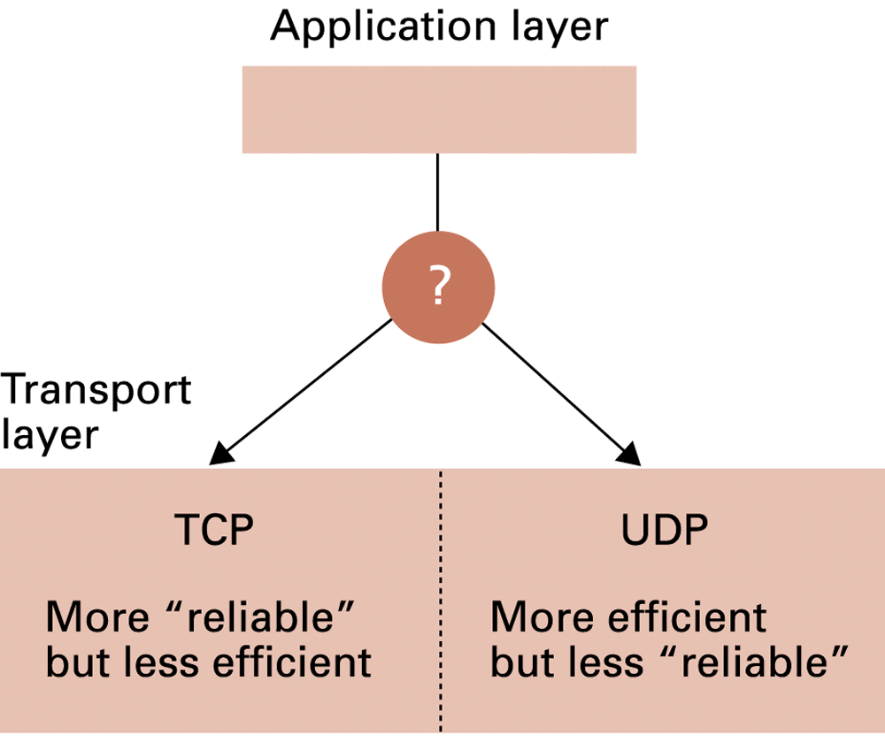
Figure 4.15 Choosing between TCP and UDP
© 2007 Pearson Addison-Wesley. All rights reserved
0-<number>

Slide 35
Security
Attacks
  Malware (viruses, worms, Trojan horses, spyware, phishing software)
  Denial of service
  Spam
Protection
  Firewalls
  Spam filters
  Proxy Servers
  Antivirus software
© 2007 Pearson Addison-Wesley. All rights reserved
0-<number>

Slide 36
Encryption
FTPS, HTTPS, SSL
Public-key Encryption
  Public key: Used to encrypt messages
  Private key: Used to decrypt messages
Certificates and Digital Signatures
© 2007 Pearson Addison-Wesley. All rights reserved
0-<number>

Slide 37
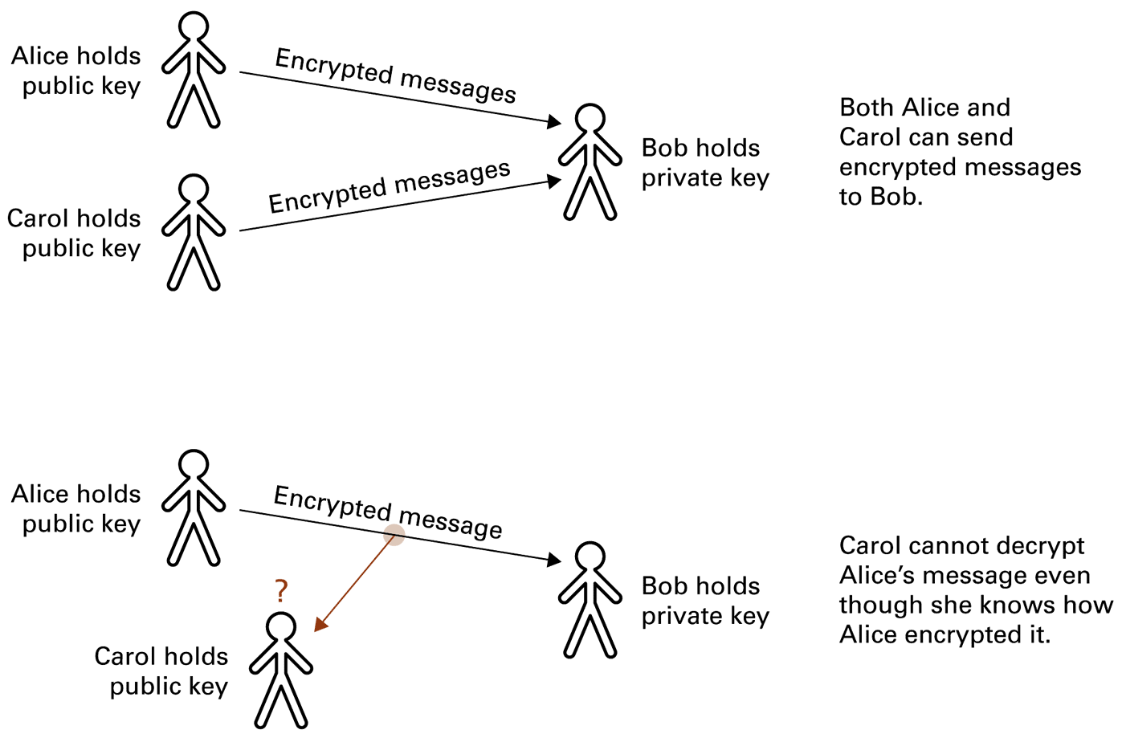
Figure 4.16 Public-key encryption
© 2007 Pearson Addison-Wesley. All rights reserved
0-<number>

Slide 38
World Wide Web
Hypertext and HTTP
Browser gets documents from Web server
Documents identified by URLs
© 2007 Pearson Addison-Wesley. All rights reserved
0-<number>

Slide 39
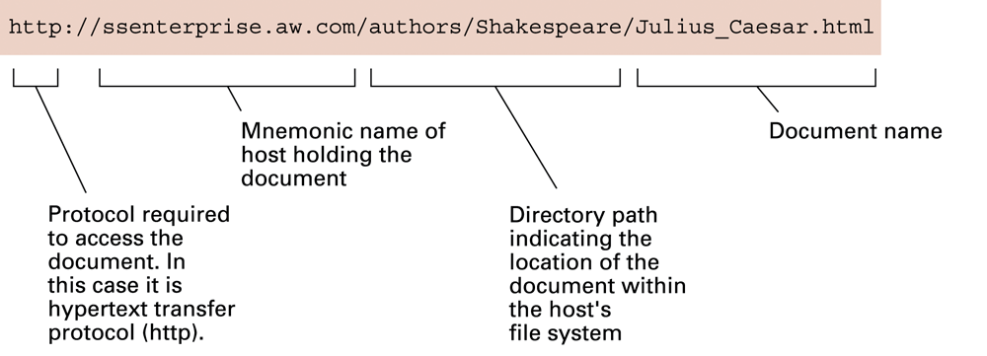
Figure 4.8 A typical URL
© 2007 Pearson Addison-Wesley. All rights reserved
0-<number>

Slide 40
Hypertext Document Format
Entire document is printable characters
Contains tags to communicate with browser
  Appearance
    <h1> to start a level one heading
    <p> to start a new paragraph
  Links to other documents and content
    <a href = . . . >
  Insert images
    <img src = . . . >
© 2007 Pearson Addison-Wesley. All rights reserved
0-<number>

Slide 41
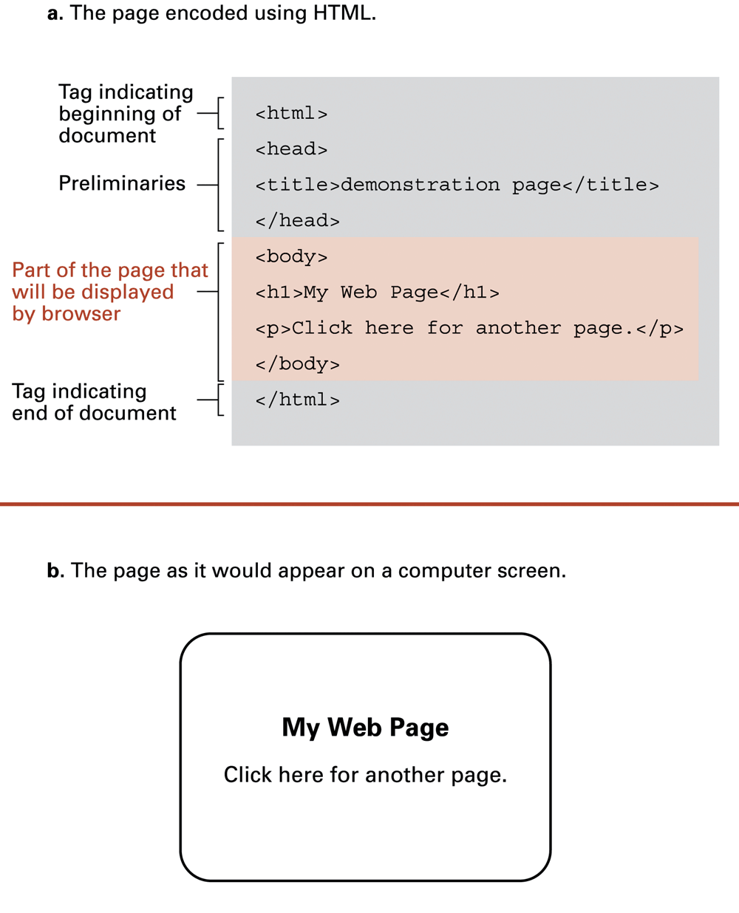
Figure 4.9 A simple Web page
© 2007 Pearson Addison-Wesley. All rights reserved
0-<number>

Slide 42
Figure 4.9 A simple Web page (continued)
© 2007 Pearson Addison-Wesley. All rights reserved
0-<number>

Slide 43
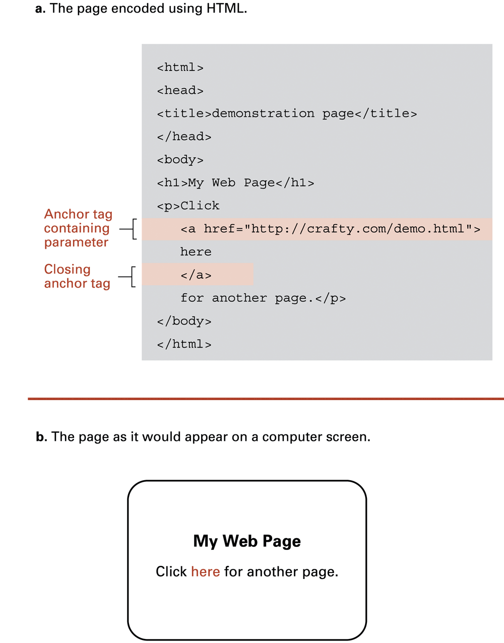
Figure 4.10 An enhanced simple Web page
© 2007 Pearson Addison-Wesley. All rights reserved
0-<number>

Slide 44
Figure 4.10 An enhanced simple Web page (continued)
© 2007 Pearson Addison-Wesley. All rights reserved
0-<number>

Slide 45
Extensible Markup Language (XML)
XML: A language for constructing markup languages similar to HTML
  A descendant of SGML
  Opens door to a World Wide Semantic Web
© 2007 Pearson Addison-Wesley. All rights reserved
0-<number>

Slide 46
Using XML
<staff clef = “treble”> <key>C minor</key>
<time> 2/4 </time>
<measure> < rest> egth </rest> <notes> egth G,
egth G, egth G </notes></measure>
<measure> <notes> hlf E </notes></measure>
</staff>
© 2007 Pearson Addison-Wesley. All rights reserved
0-<number>

Slide 47
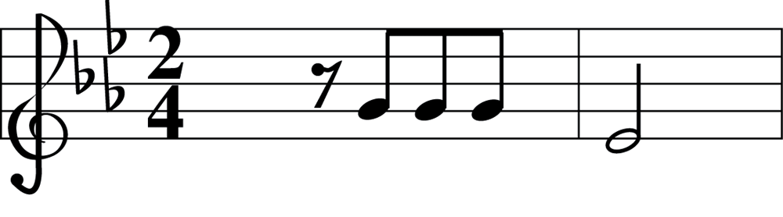
Figure 4.11 The first two bars of Beethoven’s Fifth Symphony
© 2007 Pearson Addison-Wesley. All rights reserved
0-<number>

Slide 48
Client Side Versus Server Side
Client-side activities
  Examples: java applets, javascript, Macromedia Flash
Server-side activities
  Common Gateway Interface (CGI)
  Servlets
  PHP
© 2007 Pearson Addison-Wesley. All rights reserved
0-<number>

